Slide 1
Global Warming UK GREENHOUSE GAS EMISSIONS 1990-2020
Project 1 – Group 4
Grace Cheuk (gw-sc)
Navindeep Bains (navinbains)
Salma Abdirahman (Salma-Abdirahman)
Farjana Rowther (fbrowther)

Slide 2
Agenda
01. Introduction
2. Who?
What we’re looking at and why we chose it
Which Sector produces the most emissions? And which End User is responsible for most emissions?
03. What?
04. When?
05. Closing
Which Fuel is being used to emit the most emissions?
How much has what we’re producing changed over time?
Final conclusions and analysis.

Slide 3

INTRODUCTION
Blah blah blahh

Slide 4
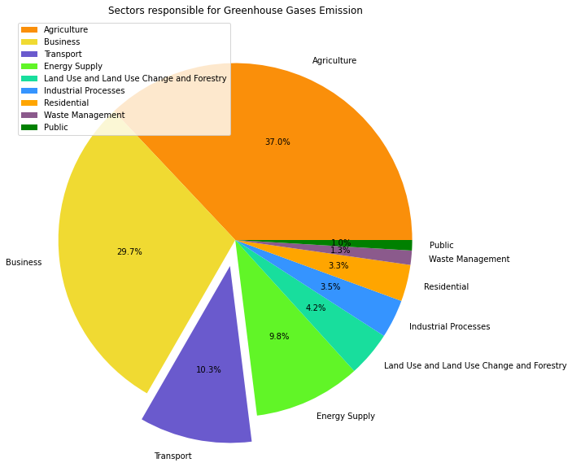
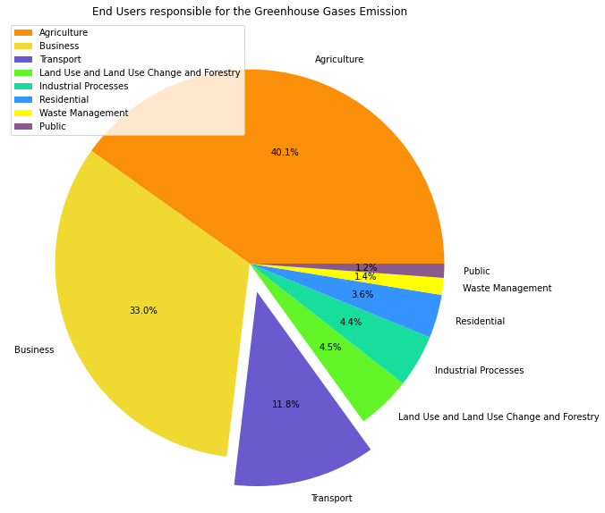
WHO?
WHICH SECTOR EMITS MOST
WHICH END USERS EMITS MOST

Slide 5
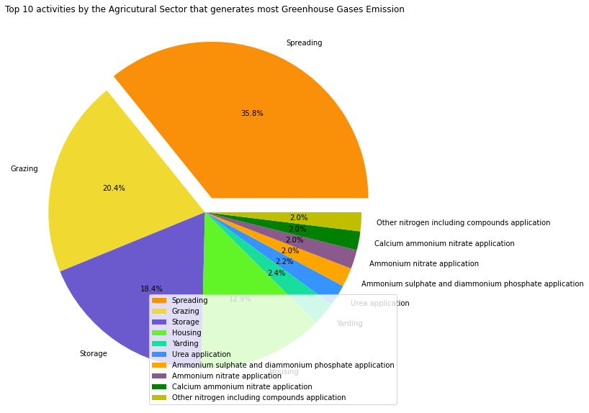
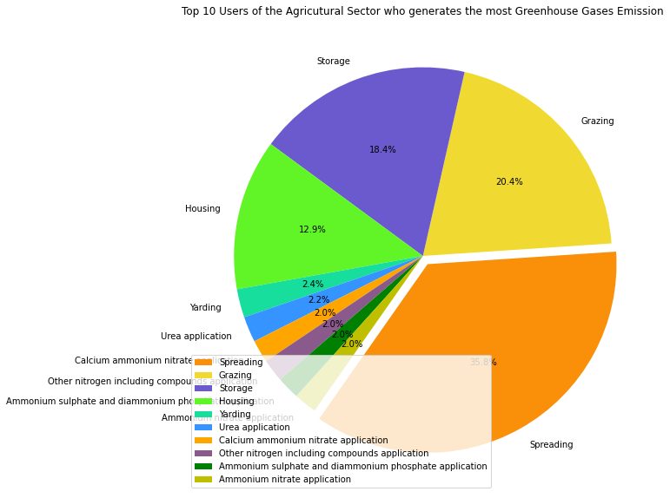
1st Contributor – Agriculture Sector
SOURCE
END-USERS

Slide 6
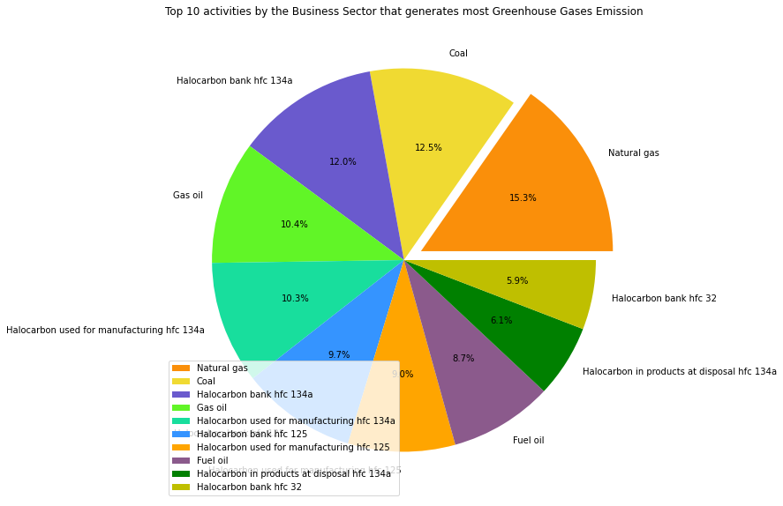

2nd Contributor - Business Sector
SOURCE
END-USERS

Slide 7
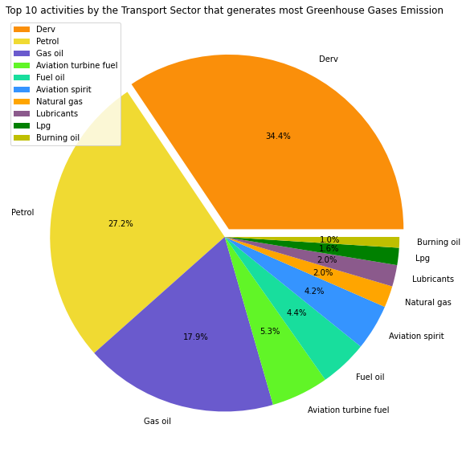
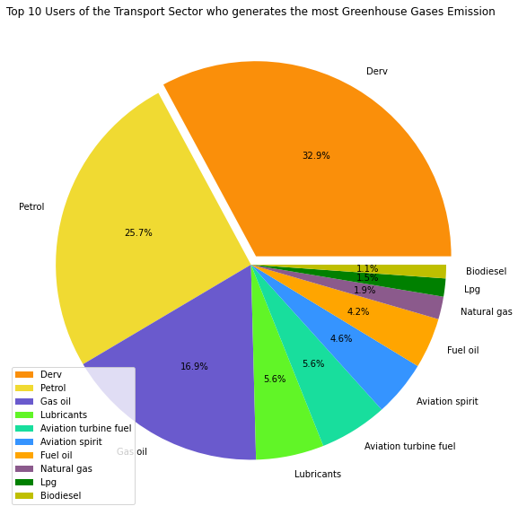
3rd Contributor - Transport Sector
SOURCE
END-USERS

Slide 8
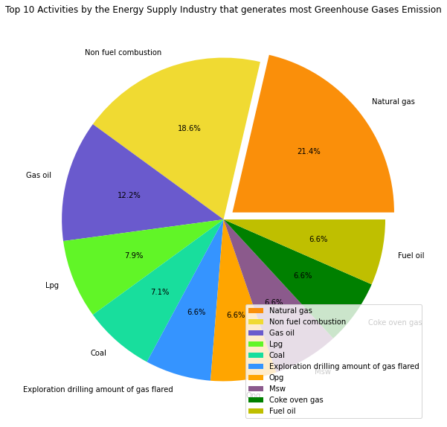
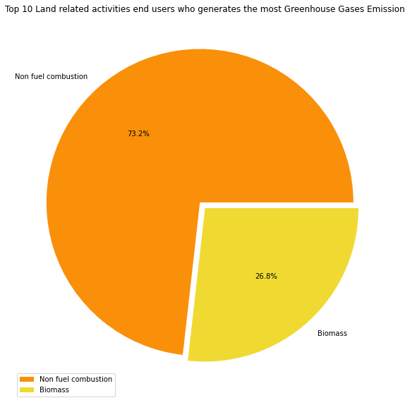
4th Contributor – Energy/Land-related Sector
SOURCE - ENERGY
END-USERS - LAND-Related

Slide 9
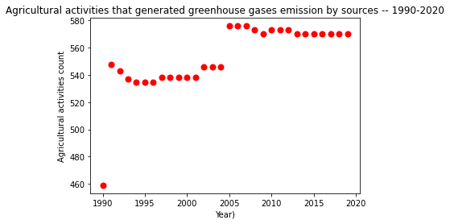
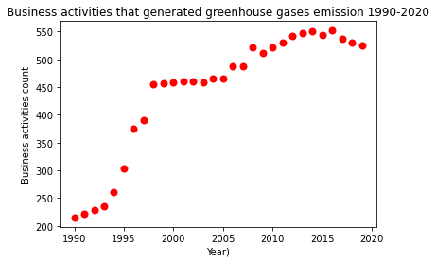
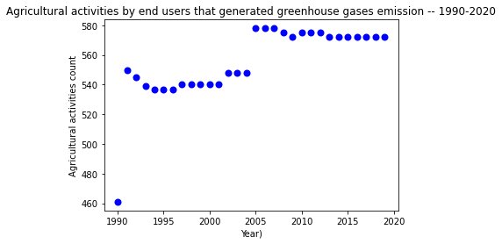
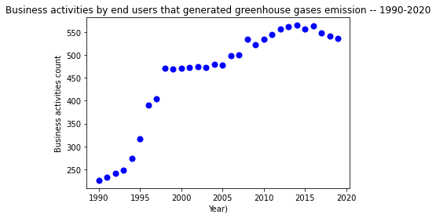
Contributor’s Trend- Agriculture & Business sector
SOURCE v/s END-USERS TREND 1990 -2020

Slide 10
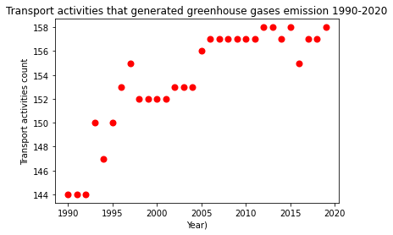
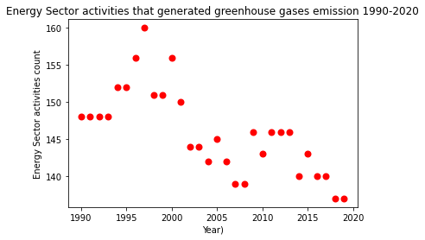
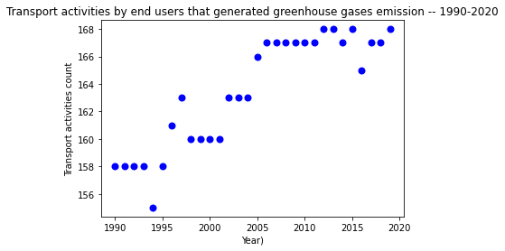
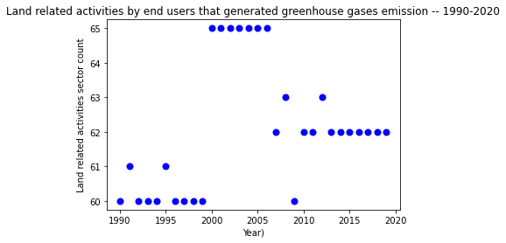
Contributor’s Trend- Transport & Energy/Land sector
SOURCE v/s END-USERS TREND 1990 -2020

Slide 11
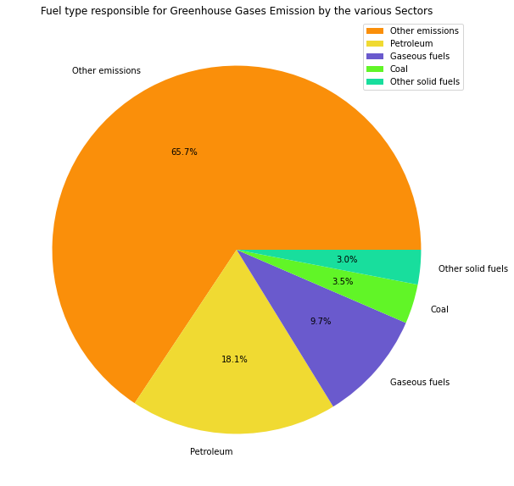
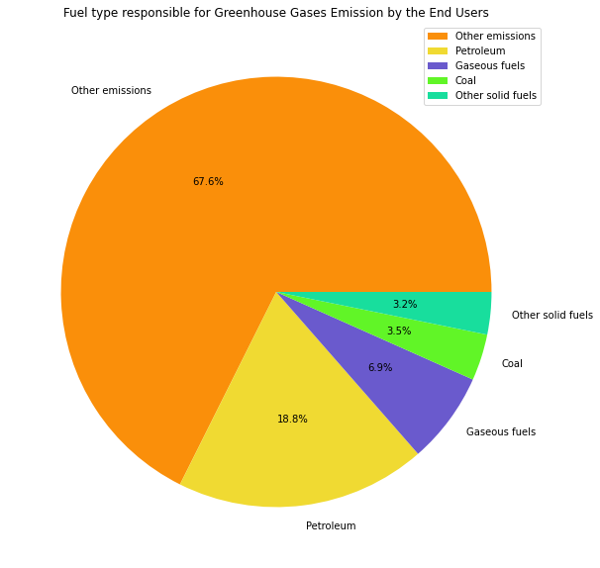
Fuel-Type
SOURCE
END-USERS

Slide 12
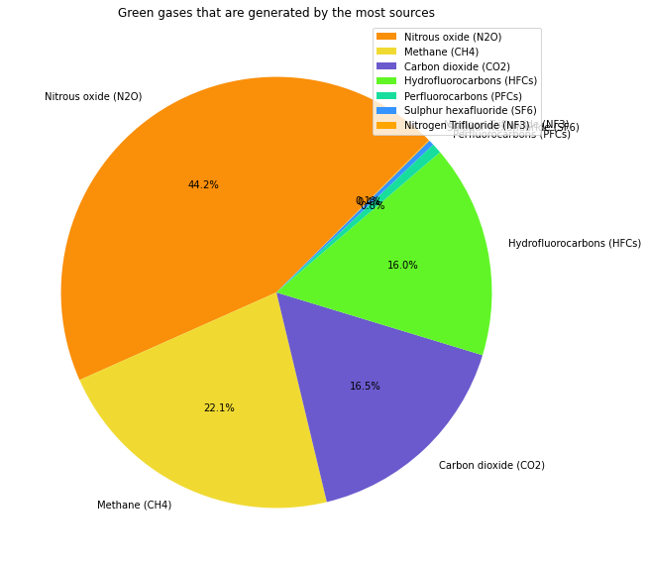

Major Components of Greenhouse Gases
SOURCE
END-USERS

Slide 13
CLOSING
WHO - SECTOR
WHEN
who
when
WHO – END USER
CONCLUSION
who
conclusion
WHAT
what

Slide 14

Thank you
Thanks to your commitment and strong work ethic, we know next year will be even better than the last.
We look forward to working together.
Group 4

